Slide 1
Plan, Schedule, Test Community Portal
Module Project
Module: NICF Capstone Project using Java
Course: NICF Advanced Certificate in Software & Applications (Development & Deployment)
Start Date : 27 July 2023
End Date : 18 August 2023
Submission Date : 18 August 2023
Learner Name : Agung Yuda Pratama
Enrollment ID : BDSE-0922-076
Presentation Date : 23 August 2023

Slide 2
Contents
Document History
Version Number | Effective Date of release | Summary of Included Changes | Author
1 | 4th March 2016 | First Edition | Satya CVS
2 | 23rd Jul 2018 | Changed for Module 6 | Shrinivas K R

Slide 3
Contents
Contents
S. No. | Description
01 | Different Types of Testing
02 | How Different Testing Helps
03 | Tests Selected
04 | Test Schedule
05 | Test Results
06 | Testing Tools
07 | Project Milestone & Tasks
08 | Milestone Feedback & Action Taken
09 | Modifications Made Based on Feedback
10 | Project Results
11 | Proposed Improvements

Slide 4
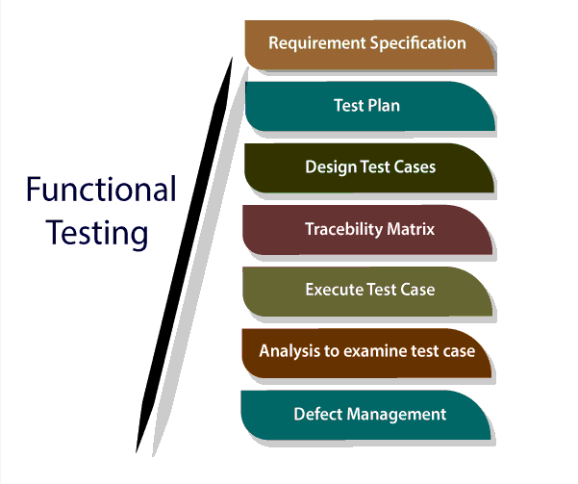
1. Different Types of Testing
List types of Testing
Functional Testing
User Acceptance Testing
Unit Testing

Slide 5
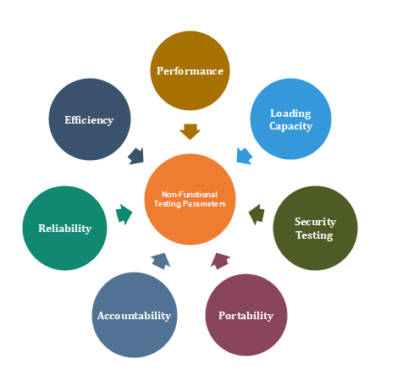
1. Different Types of Testing
List types of Testing
Non Functional Testing
Cross Browser Testing
Load Testing
Usability Testing

Slide 6
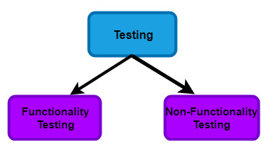
2. How Different Test Helps
Functional Testing:
Unit Tests: Unit testing ensures that individual components of the community portal work as expected. By identifying and rectifying issues at the component level, unit tests enhance the overall reliability of the codebase.
User Acceptance Testing (UAT): UAT involves real users testing the portal from an end-user perspective. UAT ensures that the portal meets user expectations by validating usability, functionality, and user experience.

Slide 7
2. How Different Test Helps
Non-Functional Testing:
1. Cross-Browser Testing: Cross-browser testing ensures the community portal functions consistently across different browsers. This guarantees a uniform user interface and proper functionality, enhancing accessibility and user satisfaction across a wider audience using diverse browser preferences.
2. Load Testing: Load testing assesses the portal's performance under various user loads. Load testing ensures the portal remains responsive and scalable. by identifying maximum user capacity. This optimization maintains a smooth and reliable user experience, even during peak usage.
3. Usability Testing: Usability testing evaluates the portal's user-friendliness and ease of use. Real users perform tasks to identify areas of difficulty or confusion. This testing improves the user interface and navigation, enhancing overall user experience and higher user satisfaction.

Slide 8
3. Tests Selected
Test Scenario ID | Test Scenario | Number of test cases
TS001-Unit Testing | Test each component in the application | 4
TS002- UAT testing | Ensure the portal’s features align with course requirements and meet users’ expectations. | 2
TS003-Cross Browser testing | Ensure the application works across multiple major browsers | 4
TS004- Load Testing | Testing the performance of the application | 2
TS005 – Usability Testing | To ensure all navigation in header and footer works properly and the content is visible | 2

Slide 9
4. Test Schedule
Web page | Weighting | Functional Points (FP) | Total
Apply for Job | 3 | 5 | 15
Post Job | 3 | 5 | 15
Thread | 3 | 5 | 15
 |  | Total functional points | 45
 |  | Estimated person hour per FP | 1.0
 |  | Total hours needed | 45
 |  | Total days needed | 8.5 days

Slide 10
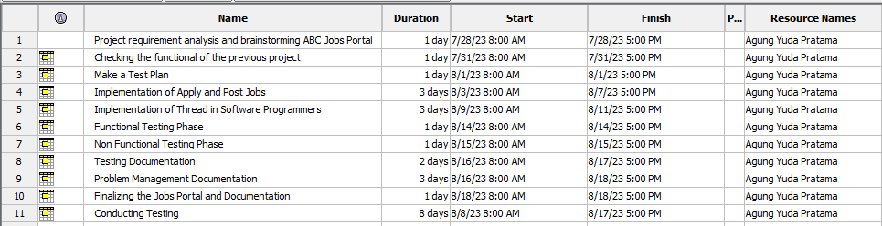
4. Test Schedule

Slide 11
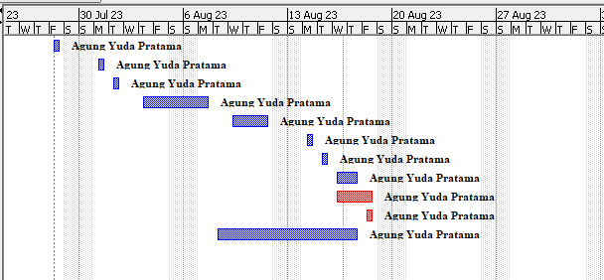
4. Test Schedule

Slide 12
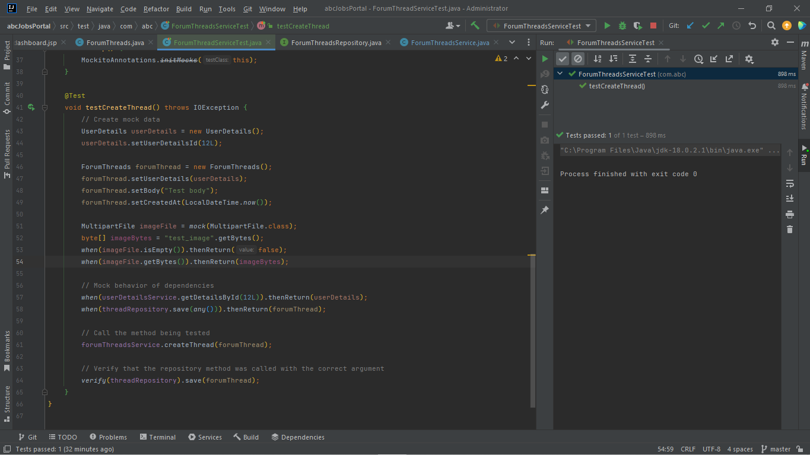
5. Test Results
Unit Testing

Slide 13
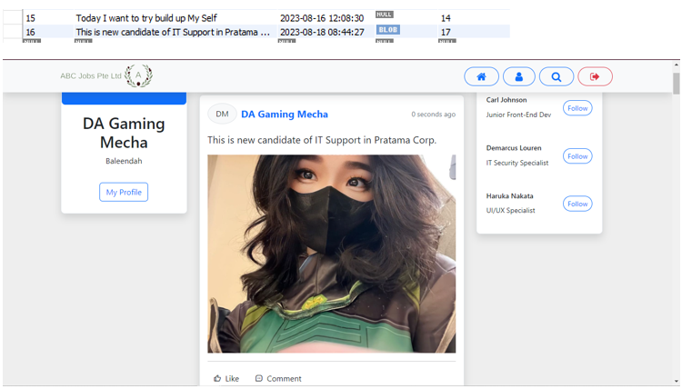
5. Test Results
UAT Testing

Slide 14
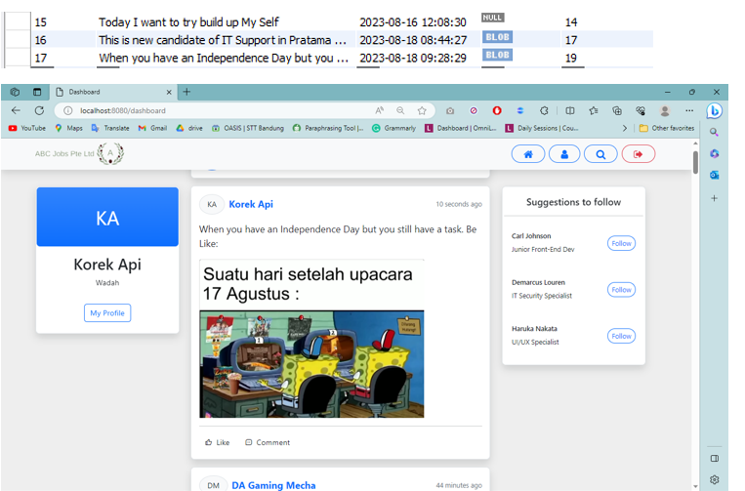
5. Test Results
Cross Browser Testing

Slide 15
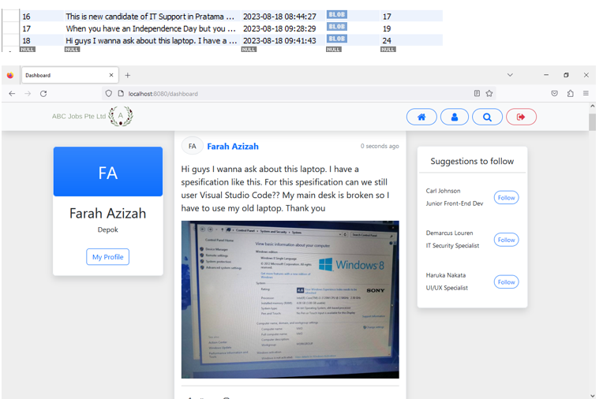
5. Test Results
Cross Browser Testing

Slide 16
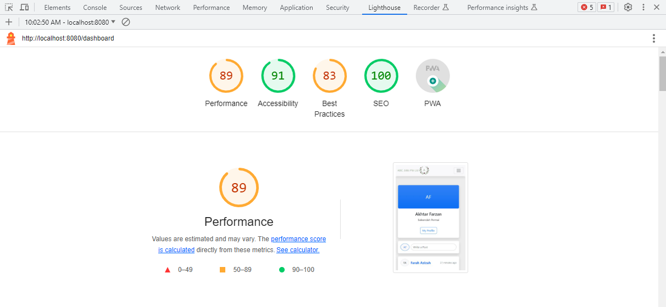
5. Test Results
Load Testing

Slide 17

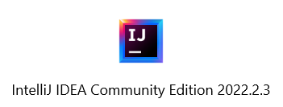
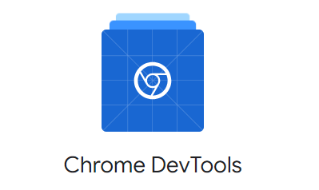



6. Testing Tools Tools
Testing Tools
JUNIT
InteliJ
Chrome Dev Tools
Lighthouse
Microsoft Edge
Mozila Firefox

Slide 18
7. Project Milestones & Tasks
Project Task ID | Project Task Description | Project Milestone ID
1 | Analyze and suggest choice of Test Methods | 1
2 | Schedule the Test Optimally | 1
3 | Develop the Phase Test Plan | 1
5 | Develop Test Cases & Scripts | 2
6 | Execute the Tests & Document the results | 3

Slide 19
8. Milestone Feedback & Action taken
Project Milestone ID | Milestone Feedback received from Tutor / Learning Facilitator | Action Taken (Yes / No)
1
2
3

Slide 20
9. Modifications Made based On Feedback

Slide 21
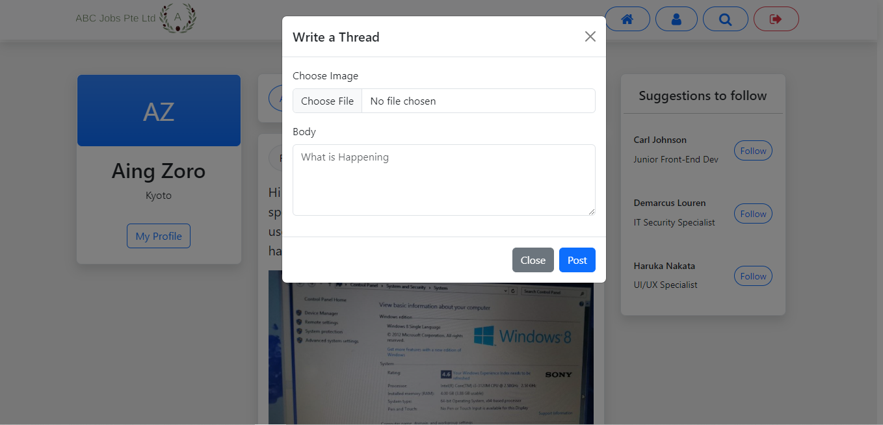
10. Project Results

Slide 22
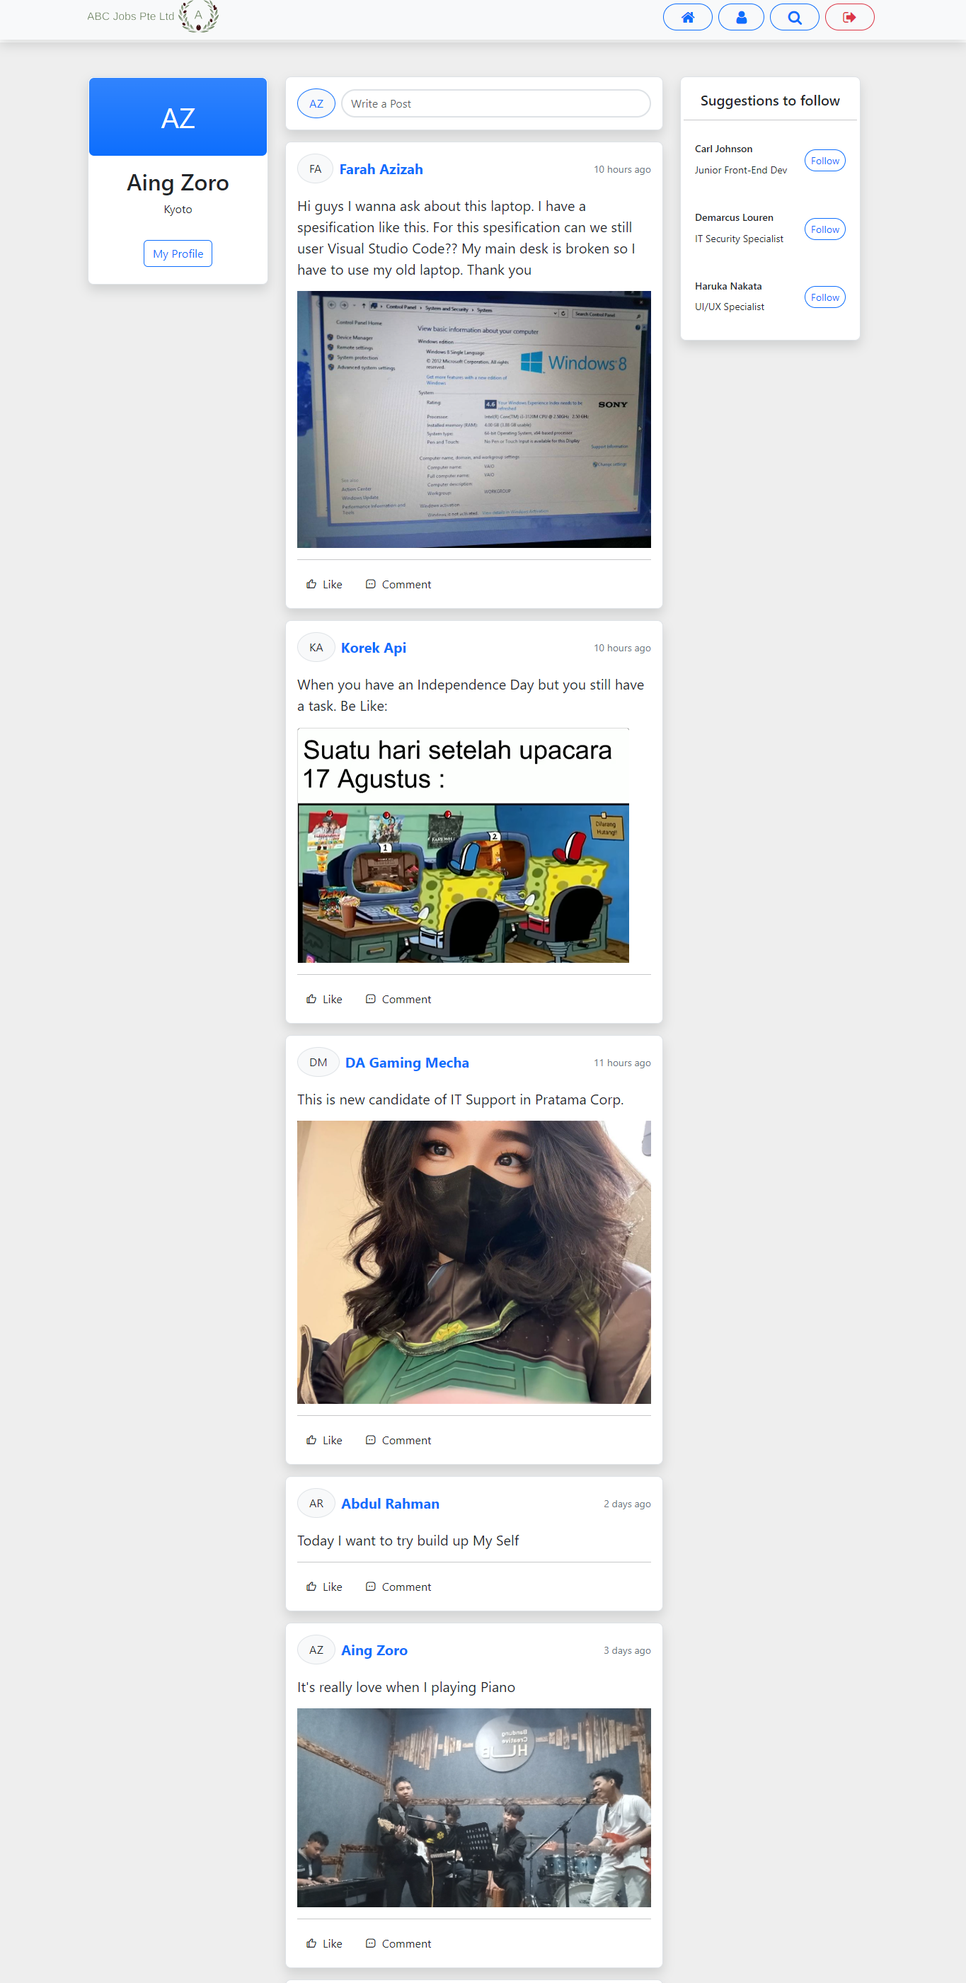
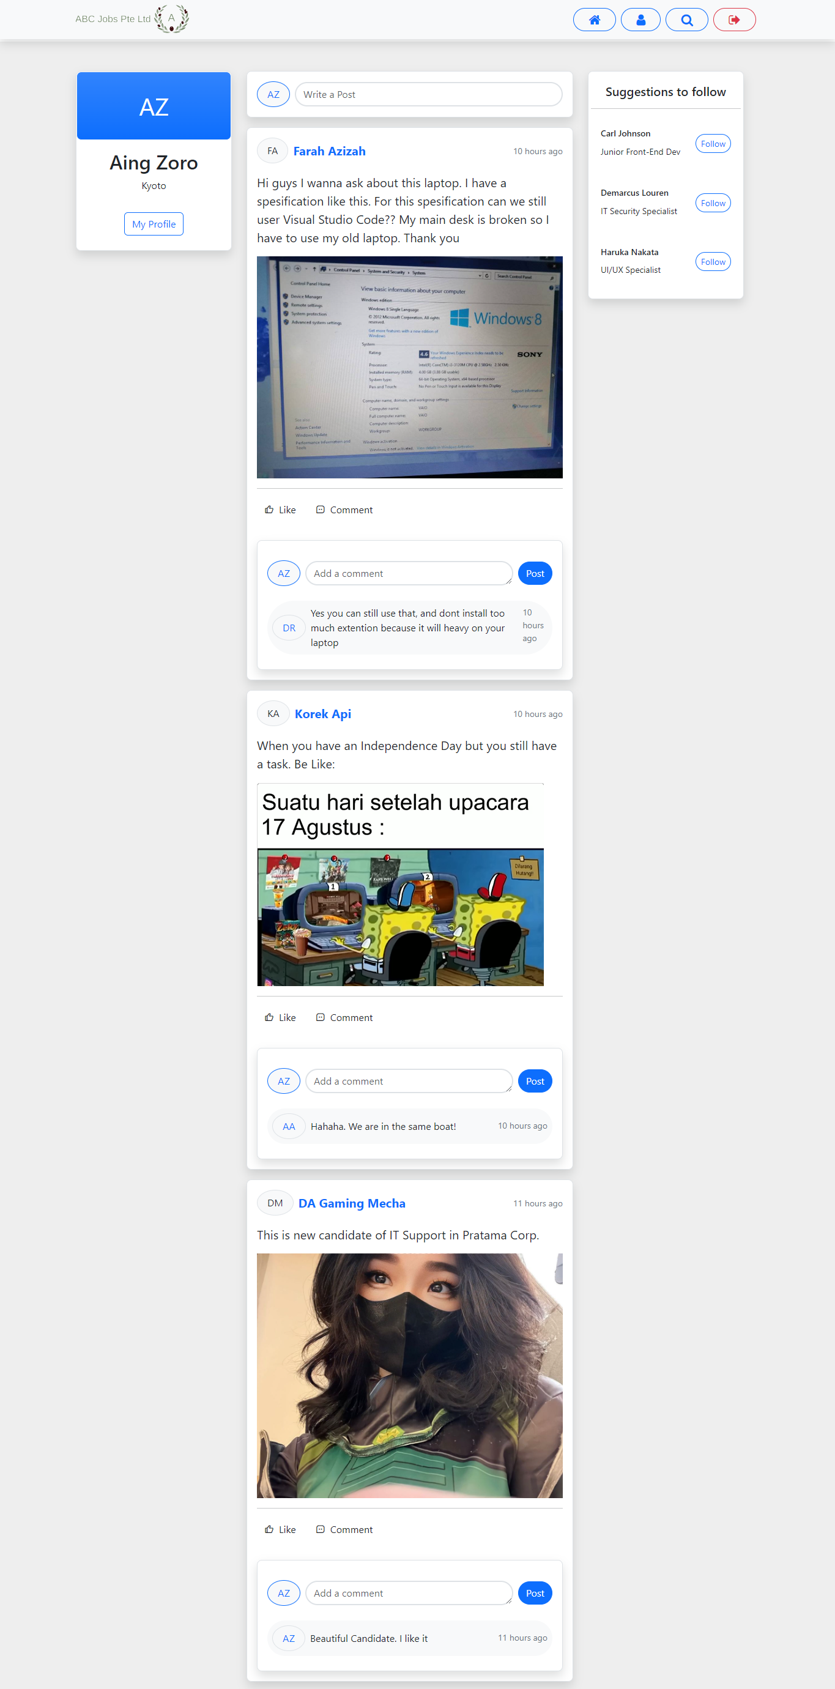
10. Project Results

Slide 23
11. Proposed Improvements
List of Improvements
Make a More interactive layout
Refresh the Design
Make Posts and Apply Job similar on LinkedIn
Add Messages Features

